Slide 1
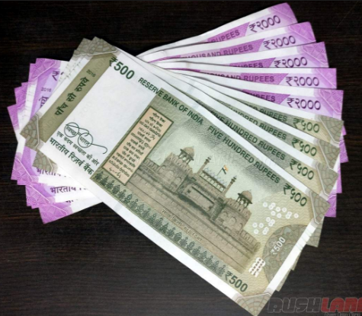
INDIA PAYROLL
Overview of Payroll in India
India Payroll Team

Slide 2
Agenda
Payroll Organization
Introduction to India Payroll
Know your Pay slip
Investment declaration and Investment proof submission
Exemption /deductions from Taxable Income
How to calculate Tax
Retiral Process
What are your next steps
Q&A

Slide 3








India Payroll – Organization Chart
Payroll Manager India
Nilendu Nandy
Payroll Advisor
Pravin Jha
Payroll Specialist
Sanjay Sundar
Payroll Functional Lead
Ravi Volur
Payroll Advisor
Deepak Thalanki
Payroll Advisor
Farahana Mohamad
Payroll Specialist
Divyaa Bharathii Manijegar
Payroll Specialist
Syaleni A Subramaniam

Slide 4
India Payroll- Overview
5 different Entities with multiple business units
2 Payroll Area with separate pay run for Locals and Expats
Key Features
Approx. 10432 pay slips generated per month
Input process managed by HR Ops
Employee queries through Sales Force
Retiral Management
Salary Payment Date – Expats – 25th of the month, Locals – 28th of the month

Slide 5
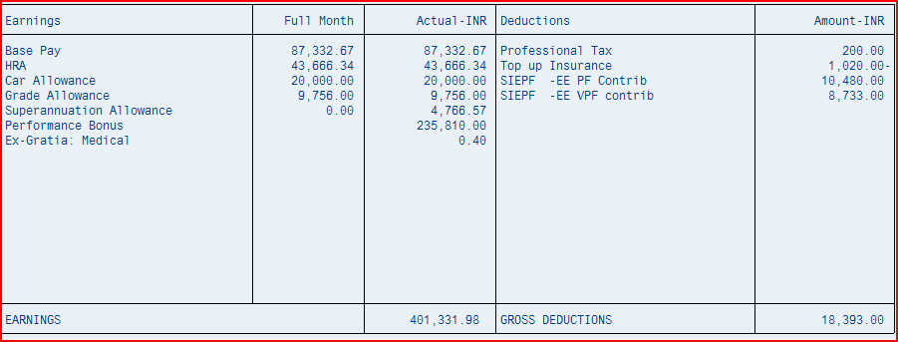
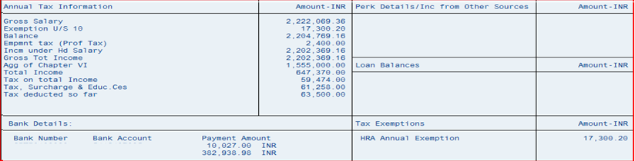
Know your Pay slip ( OLD REGIME)
All Components on the earning side are Taxable
Base pay components- tax gets projected
Negative: Refund
positive: Deduction
PF contribution is 12% of Base pay. EE’s can choose VPF contribution up to 88%
One time payment – tax deducted on the same month
HRA/Conveyance exemption
Income tax calculation is done by projecting the income up to financial year end
Includes 80CCC and 80 Others
Net pay /OOP/reimbursement

Slide 6
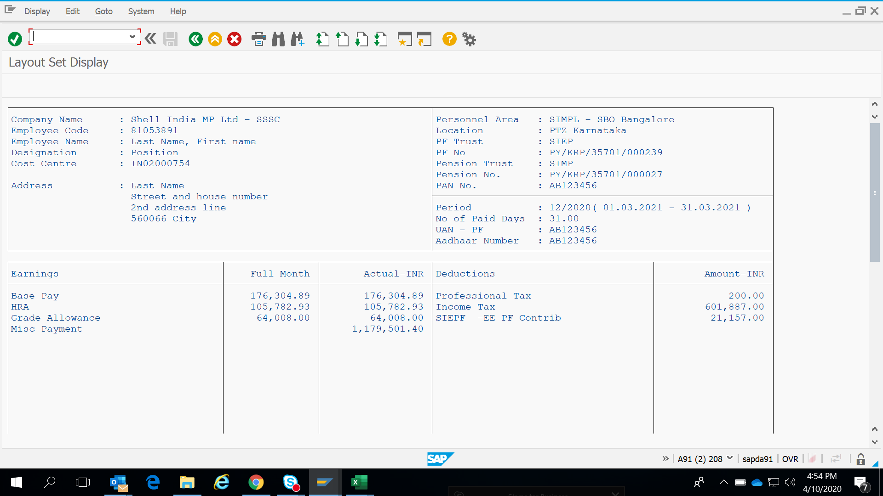
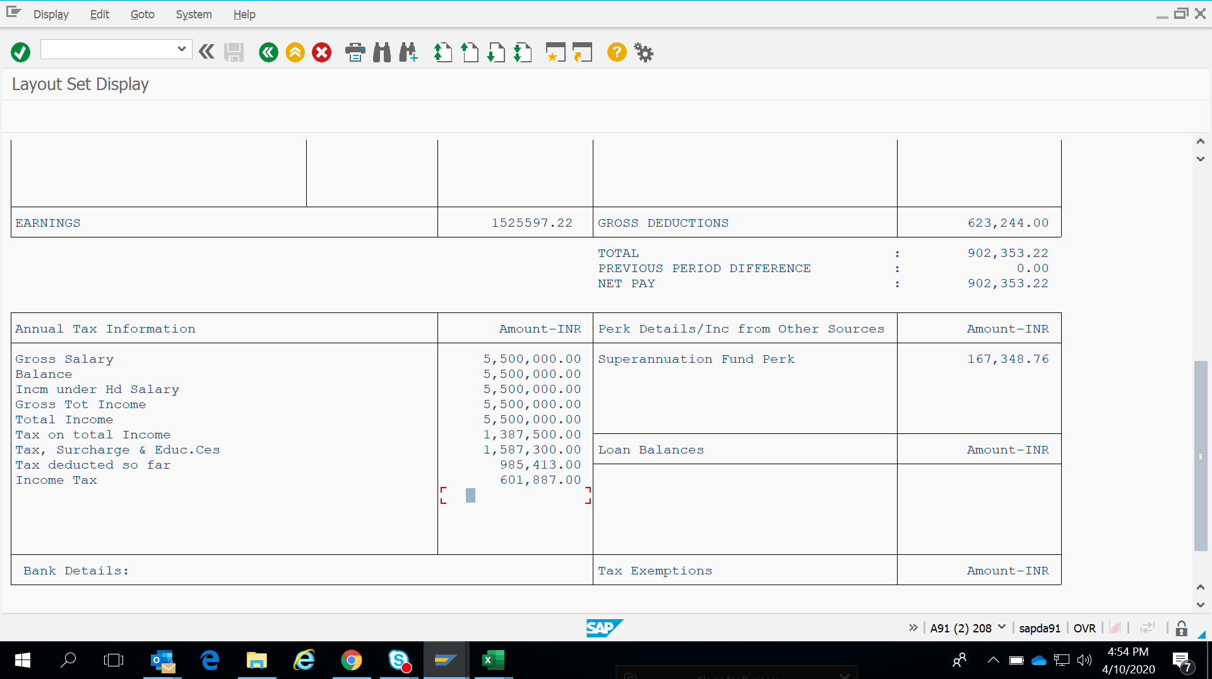
Know your Pay slip ( New Regime)

Slide 7
Investment Declaration and proof submission (Old Tax Regime)
How to update your investment declarations through Share Point and HR Online:
Share Point : For declaring New Regime or Old Regime (if not done at the time of joining, default considered is old tax regime)
https://eu001-sp.shell.com/sites/AAAAA1259/Selection%20of%20Tax%20regime%20for%20F.Y.%202021-22/overview.aspx
Share point: For updating House Rent, Interest on Housing loan and Contribution to Voluntary Provident Fund only
https://eu001-sp.shell.com/sites/AAAAA1259/Investment Declaration FY 2021-22/overview.aspx
HR Online: (Submission of declaration under section 80C and 80 Deductions)
https://shellhronline.force.com/HROnlineEC/s/my-details-and-requests
Select “My Details & Requests” tab >> Go to “Claims & Request Forms”
Click on “Section 80 Deductions” Select Investment details with “Start date 01.04.2021 End date 31.03.2022” >> Click on change >> Update declarations & Save
Click on “Section 80C Deductions” Select Investment details with “Start date 01.04.2021 End date 31.03.2022“ >> Click on change >> Update declarations & Save
Note : Please note that, amount updated under interest on education loan through HR online would not be considered if the declaration is not completed through the link below.
https://eu001-sp.shell.com/sites/AAAAA1259/Self%20declaration%20Education%20loan%20FY%202021-22/overview.aspx
Year end Investment proof submission :
The Investment proofs are collected during Nov –Jan timeframe.
The Year end Investment proof collection process is online and is managed through our vendor partner Allsec.
There would be separate communication outlining the process along with link for the online portal.
Feb and March salary is processed basis actual investment proof submitted.

Slide 8
Exemption /deductions from Taxable Income ( Applicable for Old Regime Only)
(E) Deductions under section 80C : Maximum INR 1.5 lacs
80 CCC – Pension Plan
Life Insurance Premium
Provident Fund and Voluntary Provident Fund
Public Provident Fund
NSC
NSS
Principal repayment on Housing Loan
Mutual Fund
ULIP
Tuition Fee
ELSS
Tax Saving Fixed Deposit (5 years)
(F) Deductions under section 80
80 D- Medical Insurance (25000 Non Sr Citizen/50000 Sr citizen)
80DD- Deduction in respect of medical treatment of a dependent person with disability (Rs.75000, Rs.125000/- incase of severe disability)
80DDB - Medical treatment of self/dependent person with disability (Rs.40000, Rs.100000/- for Sr Citizen
80 E - Interest on Education Loan
80EE – additional interest deduction upto INR 50000/- on housing loan (first time home buyers)
80 U - Deduction in respect of person with disability (Rs.75000/-, Rs.125000/- incase of severe disability **Certified by medical officer)
80CCD (1B): Contribution to government Pension fund Scheme (NPS) Rs.50000/-
80EEA – additional interest on housing loan interest upto INR 150000/-(first time home buyers and not eligible u/s 80EE)
80EEB – declaration for vehicle loan interest
(A) House Rent Allowance (HRA): Least of the following three options is exempt from Tax
Actual HRA Received
50% or/40% of Basic Salary (depending on metro/non metro city)
Rent Paid in excess of 10% of Basic Salary
Note :
Landlords PAN no is mandatory for claiming HRA benefit if the rent paid is >=1,00,000 per annum (>=Rs8333/- per month)
List of metro cities : Delhi/Mumbai/Kolkata/Chennai
(B) Standard Deduction : INR 50,000 is exempt from Tax
(C) Profession Tax: The actual amount of Profession Tax deducted
(D) Loss from House Property : Loss from house property under section 24 (both Self occupied / Let out property put together) is limited to INR 2,00,000

Slide 9
How to calculate Tax ( Old Regime)
Surcharge @ 10% is applicable for Income above INR 50 Lakhs
Surcharge @ 15% is applicable for Income above 1 Crore and below 3 Crores
Surcharge @ 25% is applicable for Income above 3 Crores and below 5 Crores
Surcharge @ 37% is applicable for Income above 5 Crores
Rebate u/s 87 is available up to Rs.12,500 if the taxable income is less than INR 5 Lacs
In case of Senior Citizens (Age =>60 <80 years), tax is Nil for income up to 3,00,000 and for Very Senior Citizen (Age =>80 years), tax is Nil for income up to 5,00,000.
https://www.incometaxindia.gov.in/pages/tools/income-tax-calculator.aspx
Income (amount in Lacs) | Tax Rate | Cess
Upto 2.50 | 0% | 0%
2.50 to 5.00 | 5% | 4%
5.00 to 10.00 | 20% | 4%
Above 10.00 | 30% | 4%

Slide 10
How to calculate Tax ( New Regime)
Surcharge @ 10% is applicable for Income above INR 50 Lakhs
Surcharge @ 15% is applicable for Income above 1 Crore and below 3 Crores
Surcharge @ 25% is applicable for Income above 3 Crores and below 5 Crores
Surcharge @ 37% is applicable for Income above 5 Crores
Rebate u/s 87 is available up to Rs.12,500 if the taxable income is less than INR 5 Lacs
In case of Senior Citizens (Age =>60 <80 years), tax is Nil for income up to 3,00,000 and for Very Senior Citizen (Age =>80 years), tax is Nil for income up to 5,00,000.
Income (amount in Lacs) | Tax Rate | Cess
Up to 5 | 0% | 0%
5.00 to 7.50 | 10% | 4%
7.5 to 10 | 15% | 4%
10 to 12.5 | 20% | 4%
12.5 to 15 | 25% | 4%
15 and Above | 30% | 4%

Slide 11
Overview of Shell India Retiral Structure
There are 3 Retirement benefits offered to employees on Shell Payroll in India.
The Retiral Trusts are managed by our vendor partner - DKM.
Employees can access DKM online portal through their secure login and view PF statements, nominations etc.
For all your retiral queries, logon to DKM portal and raise a ticket through the “query module”.
Provident Fund [Statutory]
Superannuation [Optional]
Gratuity [Statutory]
Regulated by Employees Provident Fund Act, under Ministry of Labour
Regulated by Payment of Gratuity Act, under Ministry of Labour
Effective 1st Sep 2017, There is only Superannuation Cash allowance offered to eligible new hires.

Slide 12

Provident Fund Contribution & Charges (Exempted Trust)
EE cont (12% of Base Pay)
ER Cont (12% of Base Pay)
Voluntary PF (up to 88% of Base Pay)
EPS 8.33% of Capped Wages
Insp. Charges 0.18% of Base Pay
EDLI 0.5% of Capped Wages
EPF (12% - EPS)

Slide 13
Gratuity
Is a mandatory benefit to be provided by employer if the number of employees crosses 10 and is governed by Payment of Gratuity Act 1972
Payable only if the employee completes 4 year 6 months of continuous service in Shell
Shell maintains its own Trust recognized by Income Tax and has a Board of Trustees.
Trust is governed by Trust Deed & Rules
Only employer contributes
Fund is currently managed by Birla Sun Life Insurance
Gratuity calculation is done as per the below formula:
(Last Drawn Base Pay X 15/26 x No. of completed year of service)

Slide 14
Superannuation
Superannuation Fund is optional retiral benefit extended by the Corporate
Contributions to this Fund are made only by the employer
Shell maintains its own Trust recognized by Income Tax and has a Board of Trustees.
Trust is governed by Trust Deed & Rules
Fund is currently managed by LIC
SA Cash allowance for new joiners effective Sep 2017.

Slide 15
What are your next steps
Declare your previous employer income and tax details using form 12B duly signed by you along with the form 16 or Income Tax computation statement duly attested by your previous employer. (upto Dec joiners)
Ensure to club your previous employment income with Salary income earned in Shell to calculate any taxes payable and accordingly pay the taxes within due date
Check your personal details on HR Online & Provide copy of PAN
Provide details of previous PF/Pension no / UAN / Aadhaar and complete Aadhaar seeding with your UAN.
Update e-nomination for PF/Pension in your UAN login.
Provide PF form11 and nomination form for Gratuity.
New Joiner can apply for VPF contribution within the 10th of next month from the DOJ.
After receiving PF number from Shell, you can apply for PF transfer (Apply in EPFO portal along with Form 13)
Update your investment declarations through Share Point and HR Online. (applicable upto Dec joiners only)
Please raise a request through service now for Share point access using the below link
https://eu001-sp.shell.com/sites/AAAAA0626/im_portal/SitePages/Permissions%20-%20Other%20Support.aspx
Please raise a ticket with HR Ops @ HR-Operations@Shell.com for all your payroll related queries.

Slide 16
THANK YOU

